Slide 1
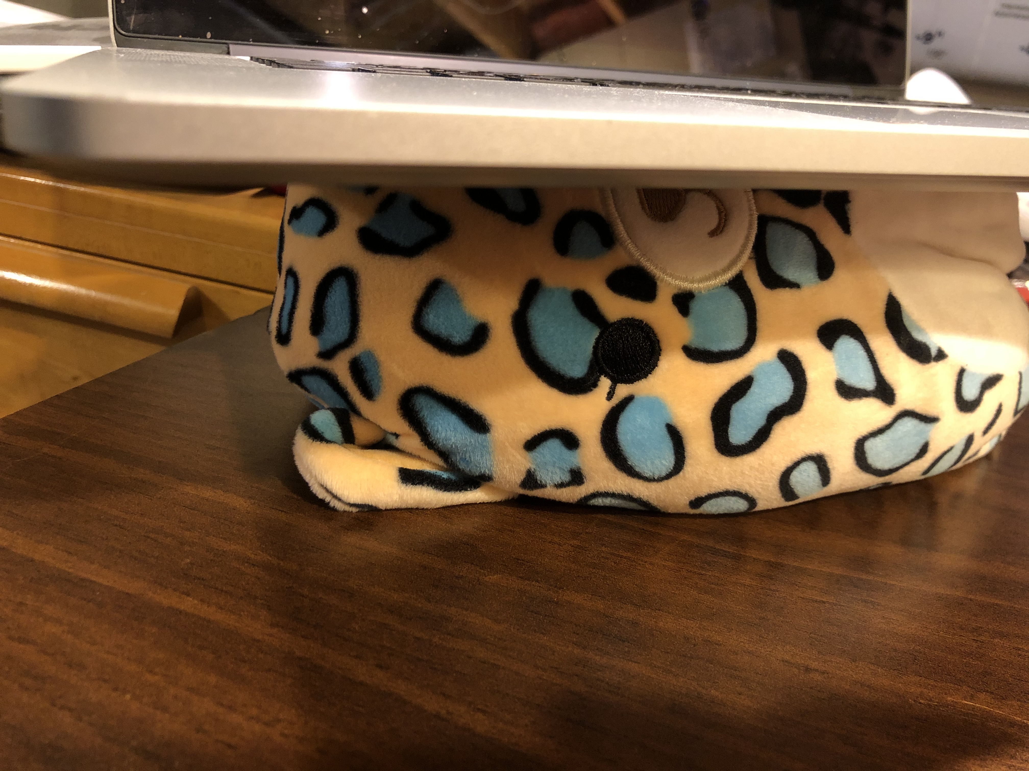
T-SQL: Squish. Shred. Boom.
@RileyMajor

Slide 2
Demos, demos, demos.
Squish: Customers and their last order.
Squish: Top 5 customers and their order counts.
Squish: Pivot tables
Shred: XML, JSON, and String_Split
Shred: Parsing a CSV
Boom: Separating phone numbers
Boom: Creating dates from thin air
Boom: Making a tally table (aka numbers table)
Boom: Testing with CROSS JOIN

Slide 3
Takeaways
Many ways to make the same query.
Best? “It depends.”
Depends on: row counts, indexes, selectivity.
Generally, try to reduce numbers before aggregating/computing.
That’s just performance. Syntax complexity and reuse matter too.
Code is read more often than it’s written.

Slide 4
Game, set, match.
For code reuse, testability, and performance:
Think in sets, not steps.
Functional, not procedural.
Separate calculation from data gathering.
Use APPLY and Derived Tables liberally.
Think of each APPLY as a function operating on data.
Actually make them inline functions, even.

Slide 5


Riley Wheeler Major
@RileyMajor
RileyMajor.com
PASSMN@RileyMajor.com
www.linkedin.com/in/rileymajor/
Enterprise Architect
Pilot Freight Services
www.PilotDelivers.com
Director of Technology, PASSMN
mnssug.org

